Slide 1

BDSS Grade 8 Day
(Tech Department)

Slide 2

Welcome!
I’m Mr. Beens. Using Chrome (not Internet Explorer - yuk!), Google “Mr Beens’ Class”. Once there, search for “Grade 8 Day” or click on the link.

Slide 3

BDSS Tech Handout
http://goo.gl/29qwqu

Slide 4
What Do We Do in
This Room?
(Tour & Discussion)

Slide 5
“Coding”
(discussion, then let’s have fun with programming Angry Birds!)

Slide 6
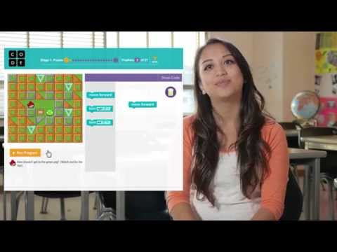
Angry Birds: http://goo.gl/j7jivs

Slide 7
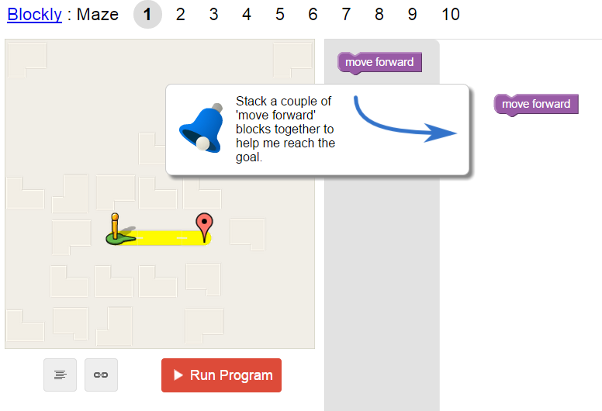
Maze URL: http://goo.gl/GbsDYw

Slide 8
Questions?
Contact me any time via email (pbeens@gmail.com) or stop by here in room 3-209.

